Slide 1
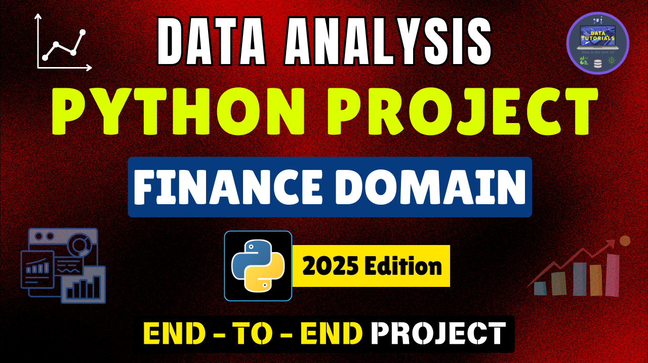

Slide 2

PROBLEM STATEMENT
BRD 1: SUMMARY
Key Performance Indicators (KPIs) Requirements:
Total Loan Applications: We need to calculate the total number of loan applications received during a specified period. Additionally, it is essential to monitor the Month-to-Date (MTD) Loan Applications.
Total Funded Amount: Understanding the total amount of funds disbursed as loans is crucial. We also want to keep an eye on the MTD Total Funded Amount metric.
Total Amount Received: Tracking the total amount received from borrowers is essential for assessing the bank's cash flow and loan repayment. We should analyse the Month-to-Date (MTD) Total Amount Receive.
Average Interest Rate: Calculating the average interest rate across all loans which will provide insights into our lending portfolio's overall cost.
Average Debt-to-Income Ratio (DTI): Evaluating the average DTI for our borrowers helps us gauge their financial health. We need to compute the average DTI for all loans.

Slide 3
PROBLEM STATEMENT
BRD 1: SUMMARY
Good Loan v Bad Loan KPI’s
Good Loan:
Good Loan Application Percentage
Good Loan Applications
Good Loan Funded Amount
Good Loan Total Received Amount
Bad Loan
Bad Loan Application Percentage
Bad Loan Applications
Bad Loan Funded Amount
Bad Loan Total Received Amount

Slide 4
PROBLEM STATEMENT
BRD 2: OVERVIEW
CHARTS
Monthly Trends by Issue Date (Line/ Area Chart): To identify seasonality and long-term trends in lending activities
Regional Analysis by State (Bar Chart): To identify regions with significant lending activity and assess regional disparities
Loan Term Analysis (Donut Chart): To allow the client to understand the distribution of loans across various term lengths.
Employee Length Analysis (Bar Chart): How lending metrics are distributed among borrowers with different employment lengths, helping us assess the impact of employment history on loan applications.
Loan Purpose Breakdown (Bar Chart): Will provide a visual breakdown of loan metrics based on the stated purposes of loans, aiding in the understanding of the primary reasons borrowers seek financing.
Home Ownership Analysis (Tree/ Heat Map): For a hierarchical view of how home ownership impacts loan applications and disbursements.
Metrics to be shown: 'Total Loan Applications,' 'Total Funded Amount,' and 'Total Amount Received'

Slide 5
